Slide 1
CodePath
Week 2
CS 4760 F18
Christopher Raley

Slide 2
Intro to SQL
SQL Injection (SQLi)
File Upload Abuse
Remote Code Execution
Topics
Week 2
Readings available on CodePath Course website

Slide 3
Data Query Languages
Languages that manage databases
XPath/Xquery, LDAP, SQL, etc.
Also known as database/query languages
CodePath uses SQL consistently throughout all activities

Slide 4
SQL
Data Query Language
Used to store, update, and retrieve information in databases
Stores data in tables
Commands like “SELECT”, “WHERE”, “FROM”, etc. are used to query data from such tables
SQL also has logical operators (AND, OR)
Let’s do some high level examples

Slide 5
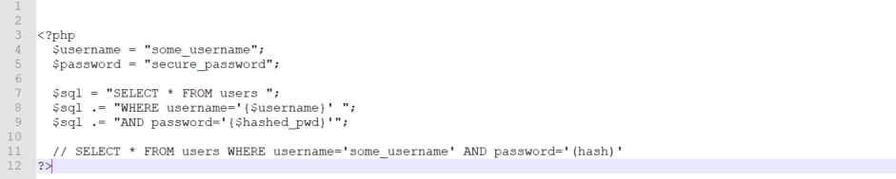
* Assuming that this is a database that actually hashes its passwords

Slide 6
SQL Injection
SQL Injection (SQLI) is when untrusted data is used to construct an SQL query. The data is inserted (or "injected") into the SQL query string.”
Ranked as #1 threat by OWASP
Easy for attackers to exploit

Slide 7
Why is this relevant?

Slide 8
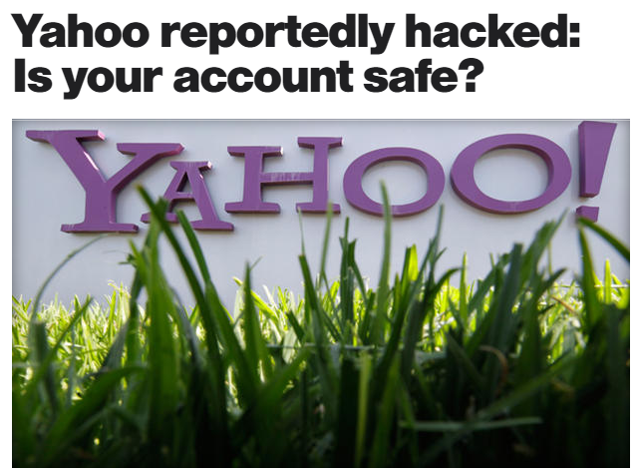
Put simply…
It’s dangerous
Around July 2012, a hacker group was able to use a “union-based SQL injection” in order to retrieve passwords that were stored in plaintext, compromising ~450,000 login credentials.

Slide 9
Recall previous SQL

Slide 10
SELECT * FROM users WHERE username=‘$username’ AND password=’$hashed_pwd’

Slide 11
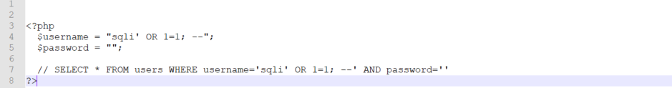
Do you see the vulnerability?

Slide 12
There’s a tautology!

Slide 13
How do you know what injections to use?

Slide 14
You don’t…
trial and error!

Slide 15
Techniques
Try enter just “ ’ ” and see what happens
Try using ” instead of ’ to close off your queries
Don’t forget about “;” and “--”
Look up SQL Cheat Sheets
Don’t get frustrated… it’s tough!

Slide 16
Lab 2
Code Injection

